Slide 1
Marketing Campaign ROI Analysis
By Ujjawal Chaudhary

Slide 2
Introduction
I am a data analyst at GlowUp, a beauty and skincare startup that recently ran multiple online and offline marketing campaigns. The company spent a significant budget on social media ads, influencer collaborations, and local events. Management wants to understand which campaigns delivered the best return on investment (ROI) and how to allocate marketing budgets efficiently in the future.

Slide 3
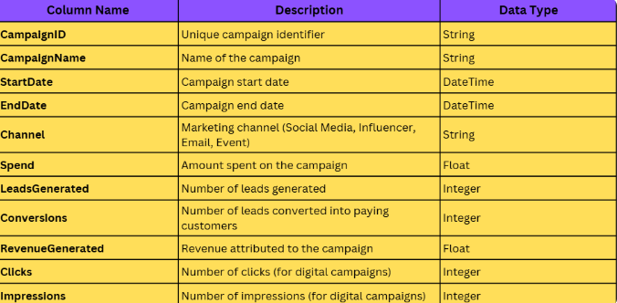
Dataset Overview

Slide 4
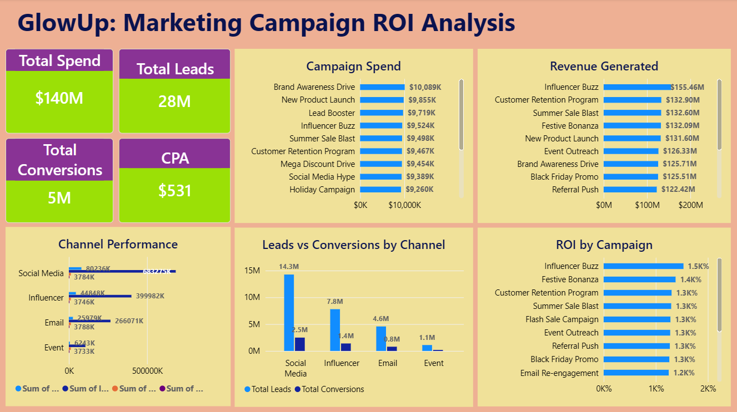
Glimpse of Dashboard

Slide 5
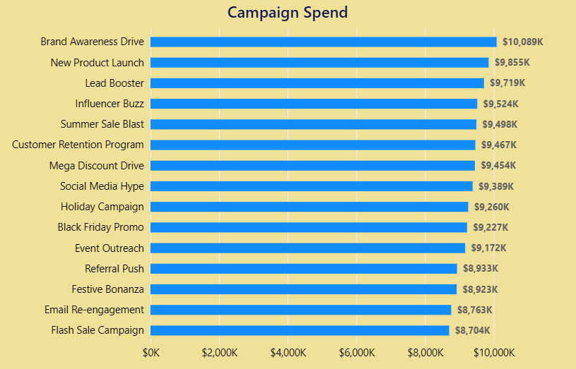
Campaign Spend
Key Observations & Recommendations
Brand Awareness Drive and New Product Launch received the highest campaign spend, indicating stronger budget allocation toward awareness-focused marketing campaigns.
Flash Sale Campaign and Email Re-engagement received comparatively lower spending, showing lower investment priority among campaigns.
Evaluate whether high-spend campaigns are generating proportional ROI and conversions before increasing future budget allocation.
Consider increasing investment in lower-spend campaigns if they demonstrate strong ROI or conversion efficiency.

Slide 6
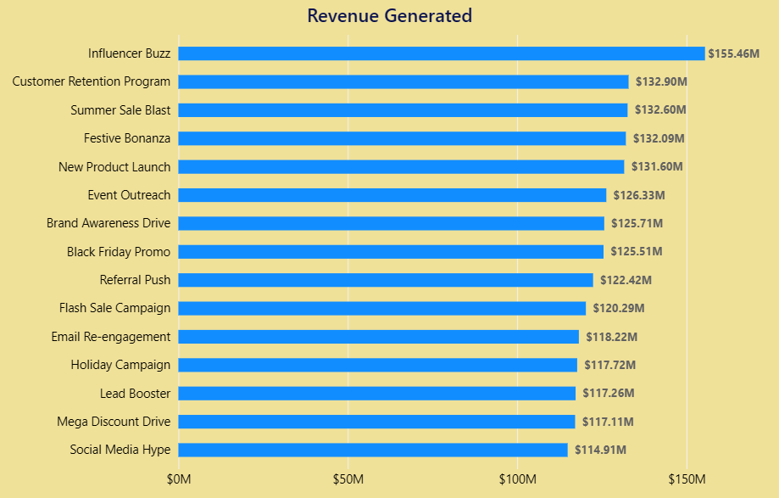
Revenue Generated
Key Observations & Recommendations
Influencer Buzz generated the highest revenue (~155M), making it the top-performing campaign in terms of sales generation.
Social Media Hype and Mega Discount Drive generated comparatively lower revenue among all campaigns.
Increase investment in high-revenue campaigns like Influencer Buzz and Customer Retention Program to maximize future returns.
Re-evaluate low-revenue campaigns by improving campaign strategy, targeting, and promotional offers.

Slide 7
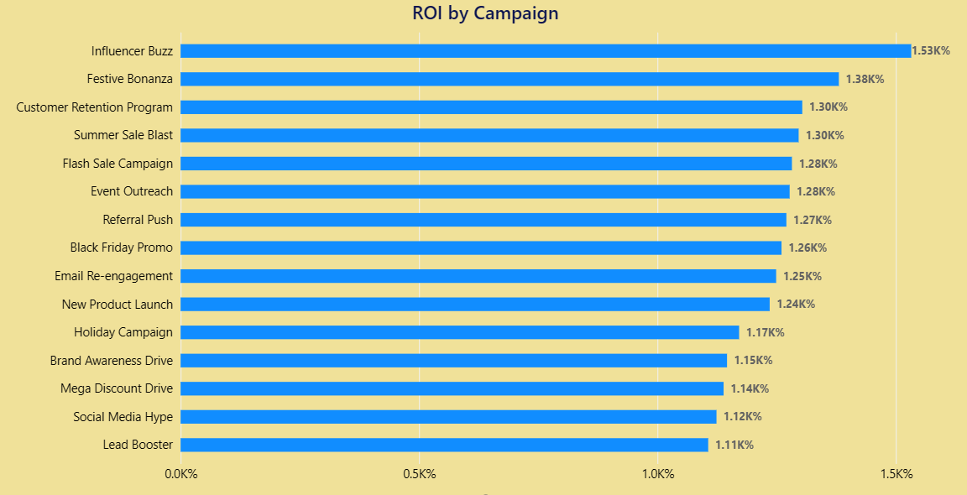
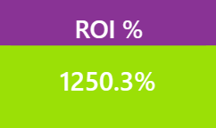
ROI (%): (Revenue – Spend) / Spend × 100)
Key Observations & Recommendations
Influencer Buzz generated the highest ROI (~1390%), making it the best-performing campaign.
Summer Sale delivered the lowest ROI among all campaigns, despite marketing investment.
Increase future budget allocation toward high-performing campaigns like Influencer Buzz and Festive Bonanza.
Rework low-ROI campaigns by improving targeting, offer strategy, or campaign timing.

Slide 8
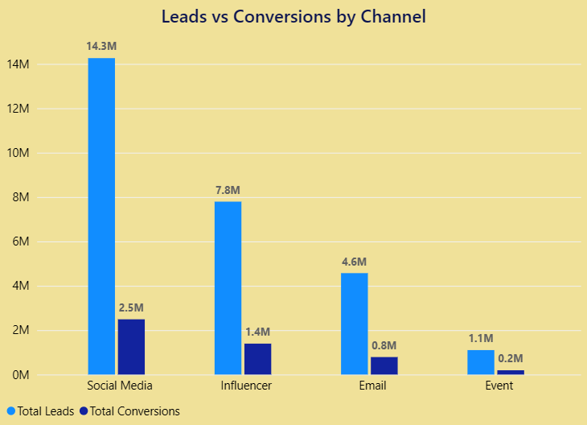
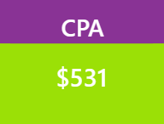
Conversions & CPA
Key Observations & Recommendations
Social Media generated the highest number of leads and conversions compared to other channels.
The overall CPA remained relatively low, indicating cost-efficient customer acquisition performance.
Prioritize high-conversion channels like Social Media and Influencer Marketing.
Continuously monitor CPA to maintain acquisition efficiency while scaling campaigns.

Slide 9
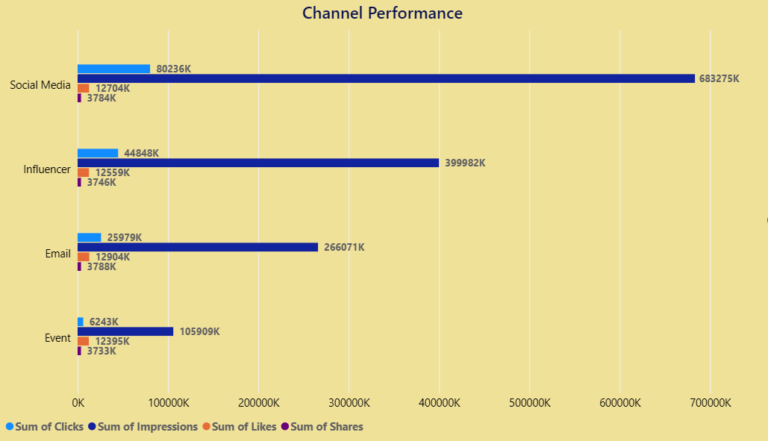
Engagement Metrics
Key Observations & Recommendations
Social Media generated the highest impressions, clicks, likes, and shares among all channels, indicating the strongest audience engagement.
Event marketing showed the lowest engagement performance across all engagement metrics compared to digital channels.Prioritize high-conversion channels like Social Media and Influencer Marketing.
Increase focus on high-engagement channels like Social Media and Influencer Marketing to maximize audience reach and interaction.
Improve engagement strategies for lower-performing channels by using better content, targeting, and promotional campaigns.

Slide 10
Strategic Recommendation
Quick Wins
Reallocate more budget toward high-ROI campaigns like Influencer Buzz and Festive Bonanza to maximize immediate revenue growth.
Optimize low-performing campaigns such as Summer Sale and Mega Discount Drive through better audience targeting and offer strategy.
Increase focus on high-engagement digital channels like Social Media and Influencer Marketing to improve conversions at lower CPA.
Long-Term Strategies
Build a data-driven marketing allocation model based on ROI, CPA, and conversion trends for smarter future budgeting.
Strengthen customer retention and loyalty campaigns to improve repeat purchases and long-term customer lifetime value.
Invest in personalized and AI-driven campaign targeting to enhance engagement, conversion efficiency, and overall marketing performance.

Slide 11
Thank You
Prepared by: Ujjawal Chaudhary

